Slide 1

MULTIMODAL PERSON IDENTIFICATION SYSTEM
Presented by:
Prithvish V N (13BEC1100)
Shraddha Agrawal (13BEC1138)
Guided by:
Prof. John Sahaya Rani Alex

Slide 2
OBJECTIVE :
To fuse more than two human traits or biometrics for improved performance and exclude all the discrepancies of a conventional single-feature person identification system.
To minimize the computational cost of the system by reducing the dimensionality of data and achieve high processing speed.
To make this whole system cost effective and portable.

Slide 3
INTRODUCTION :
Person identification is of paramount importance in security, surveillance, human computer interfaces, and smart spaces.
Traditional methods :
Token : may be lost, stolen, forgotten, forged or misplaced
Password : may be forgotten or compromised
Biometric Identification : automatic identification of a person based on his/her physiological or behavioral characteristics
Nine different biometric indicators are either widely used or under intensive evaluation
face, facial thermogram, voice-print, signature, fingerprint, hand geometry, hand vein, lip movement, iris, retinal pattern.

Slide 4
Why multimodal approach?
All these biometric indicators have their own advantages and disadvantages in terms of the accuracy, user acceptance, and applicability.
A single feature, however, sometimes fails to be exact enough for identification.
Consider identical twins, for example. Their faces alone may not distinguish them.
Another disadvantage of using only one feature is that the chosen feature is not always readable.
For example, some five percent of people have fingerprints that cannot be recorded because they are obscured by a cut or a scar or are too fine to show up well in a photograph
To enable a biometric system to operate effectively in different applications and environments, a multimodal biometric system which makes a person identification based on multiple physiological or behavioral characteristics is preferred.

Slide 5
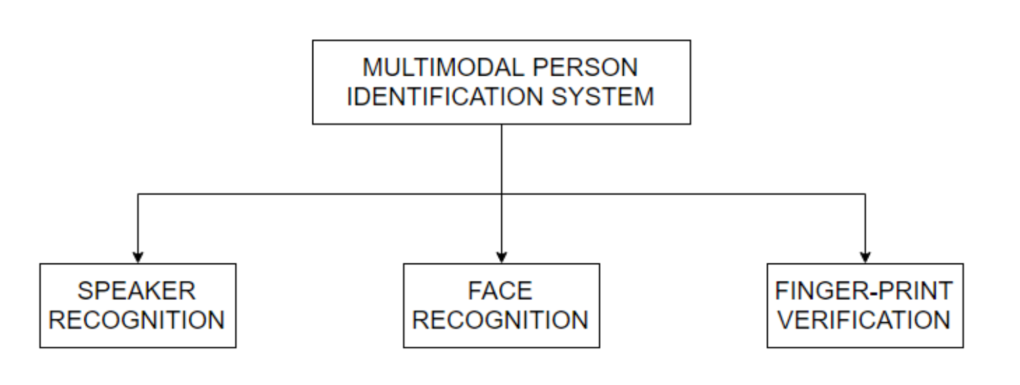
Our approach:
Fig. 1 Biometric indicators used in our system
Routinely used in law enforcement community.
Most of the commercial biometric systems currently rely on either of these three.
These biometric indicators complement one another in their advantages and strengths

Slide 6
The verification process essentially consists of four stages :
1) Fingerprint verification
2) Face recognition
3) Speaker verification
4) Decision fusion

Slide 7
FINGERPRINT VERIFICATION
Fingerprint verification depends on the comparison of minutiae and their relationships to make a personal identification.
It usually consists of two stages:
minutiae extraction
minutiae matching
Fig. 2 Flow for fingerprint verification

Slide 8
Binarization :
enables to remove any noise from the image
helps to make the contrast better between the skin and the wrinkled surface of the finger
done through local thresholding
Skeletization :
create more unique and stronger interest points
based on the ZhangSuen line-thinning approach
Harris corner detector :
to detect strong corners and edges
scale and illumination variation independent
Harris Corners are stored as positions corresponding with their cornerness response value in the image
ORB descriptor :
Since we have an application where the orientation of the thumb can differ (since it is not in a fixed position)
ORB uses an orientation compensation mechanism, making it rotation invariant

Slide 9
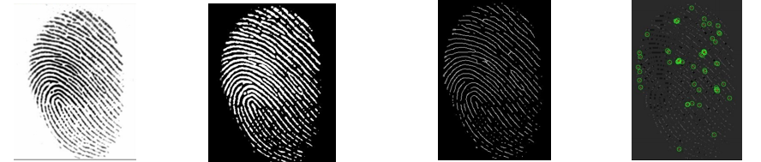
Grayscale image Binarization Skeletization Harris corners
Fig. 3 Fingerprint verification

Slide 10
Testing :
Descriptors matrix contains a row for each keypoint containing the representation
A database containing a set of feature descriptors for the training persons in the database
To match descriptors of the new fingerprint input to the descriptors stored in the database, to see which one has the best match.
The simplest way to do this is to perform brute-force matching using the hamming distance criteria between descriptors of different keypoints.

Slide 11
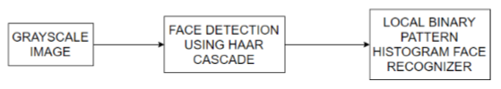
FACE RECOGNITION
Face recognition refers to static, controlled full frontal portrait recognition.
Two major tasks involved:
face detection
face recognition
Fig. 4 Flow for face recognition

Slide 12
Face Detection
Done through Haar Cascade provided by OpenCV
For something like a face, you might have around 6,000 classifiers per block, all of which must match for a face to be detected
The OpenCV Haar cascade breaks the problem of detecting faces into multiple stages (30-50 cascades).
For each block, it does a very rough and quick test. If that passes, it does a slightly more detailed test, and so on.
It will only detect a face if all stages pass.
The advantage is that the majority of the pictures will return negative during the first few stages, which means the algorithm won’t waste time testing all 6,000 features on it

Slide 13
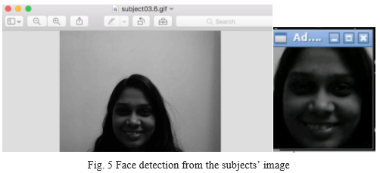
Face detection :

Slide 14
Face Recognizer
The face recognition method is divided in two stages
training stage
operational stage
Based on pure pixel, research has proven that faces are not unique enough.
There is a need to gather a tremendous amount of facial features, which makes it even more complex.
To make a derivate face representation, based on a single feature descriptor, for each person represented in a specific feature space, so that it is easier to separate different from each other

Slide 15
Face recognizer
There are three possibilities :
Eigenfaces: Eigenvalue decomposition through PCA.
Fisherfaces: Linear discriminant analysis using the Fisher criterion.
LBPH: Local Binary Pattern Histogram comparison
The use of local binary pattern intensity histograms is a technique that looks at local face information rather than looking at global face information for a single individual.
It helps to cope with problems like
partial occlusion
Illumination
small sample size

Slide 16
Face detection :
cascadePath = "haarcascade_frontalface_default.xml" faceCascade = cv2.CascadeClassifier(cascadePath);
Face recognizer :
recognizer = cv2.createLBPHFaceRecognizer()
The face recognizer object has functions like FaceRecognizer.train to train the
recognizer and FaceRecognizer.predict to recognize a face.

Slide 17
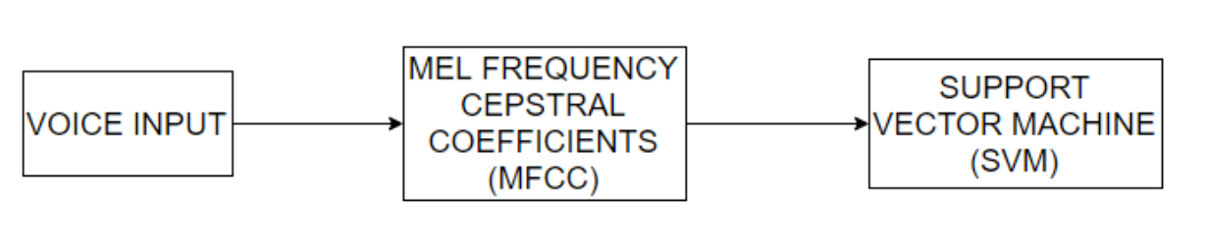
SPEAKER VERIFICATION
Anatomical variations that naturally occur amongst different people and the differences in their learned speaking habits manifest themselves as differences in the acoustic properties of the speech signal. By analyzing and identifying these differences, it is possible to discriminate among speakers.
The project implements a text independent speaker recognition system which uses Mel Frequency Cepstral Coefficients (MFCC) followed by a Support Vector Machine (SVM).
Fig. 6 Flow for speaker verification

Slide 18
MFCC
The first step in any automatic speech recognition system is to extract features i.e. identify the components of the audio signal that are good for identifying the linguistic content and discarding all the other stuff which carries information like background noise, emotion etc.
The main point to understand about speech is that the sounds generated by a human are filtered by the shape of the vocal tract including tongue, teeth etc.
If we can determine the shape accurately, this should give us an accurate representation of the phoneme being produced.
The shape of the vocal tract manifests itself in the envelope of the short time power spectrum, and the job of MFCCs is to accurately represent this envelope.

Slide 19
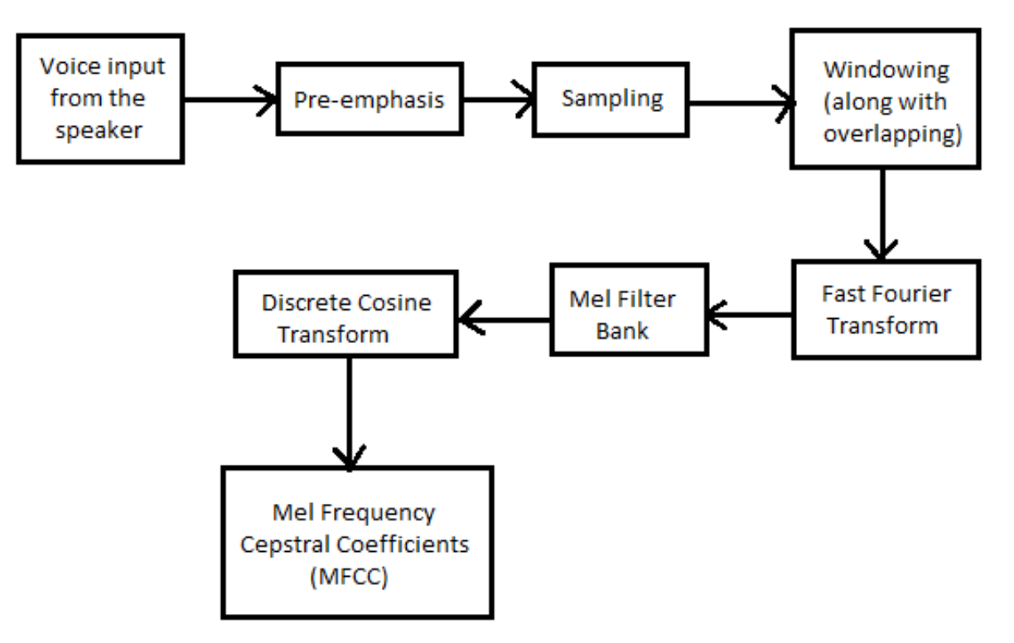
Computing MFCC
Fig. 7 Block diagram to compute MFCC

Slide 20
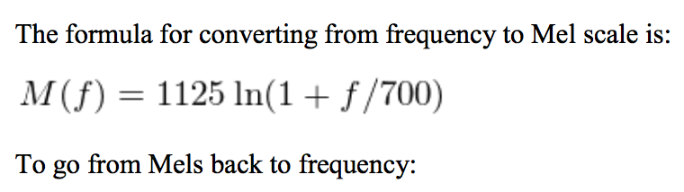

Mel scale :

Slide 21
Decision Fusion
The final decision made by the system is based on the integration of the decisions made by the fingerprint verification module, the face recognition module, and the speaker verification module.
The consensus problem requires agreement among a number of processes (or agents) for a single data value.
The processes must somehow put forth their candidate values, communicate with one another, and agree on a single consensus value.

Slide 22
Standards
International standards
PEP-8
UART
SSH
IEEE 802.3
Open source standards
OpenCV
ALSA
ORB
IMAGEMAGICK

Slide 23
CONSTRAINTS
Face Detection using Haar cascade is most effective only on frontal images of faces. It can hardly cope with 45° face rotation both around the vertical and horizontal axis. Face detection alone is sensitive to lighting conditions. We might get multiple detections of the same face, due to overlapping sub-windows.
In case of noisy environments the accuracy of our speaker verification system might be less.
Finger orientation while acquiring the input for finger print verification module might create an issue. However the use of ORB descriptor takes care of rotation variance.
Unable to capture 3D depth information while taking input for face and finger print verification might encourage some fraudulent activities.
Scars, bruises on faces and finger, disruption in voice data captured due to throat illness might not be accounted by our system. However multimodal approach takes care if there is a problem in any such module

Slide 24
RESULTS
The combined approach increases the efficiency to a decent level making the system ready to implement in real life.
The project scope lies to cost reduction and implementation section over BBB making the whole system portable.

Slide 25
CONCLUSION
A multimodal biometrics technique, which combines multiple biometrics in making a personal identification, can be used to overcome the limitations of individual biometrics.
We have developed a multimodal biometric system which integrates decisions made by face recognition, fingerprint verification and speaker verification to make a personal identification. In order to demonstrate the efficiency of such an integrated system, experiments which simulate the operating environment on a small data set which is acquired in a strict environment were performed.
The experimental results show that our system performs very well.
However, the system needs to be tested on a large dataset in a real operating environment.
We were successful in making our system portable.
Our system supports both training and testing, make it a ready to deploy system in the market with no dependencies.

Slide 26


